Slide 1
Input
B×C×H×W×2
Reshape + Groups
2C//G×H×W
X Avg Pool
Y Avg Pool
2C//G×1×W
2C//G×H×1
Concat + Conv (1×1)
Conv(3×3)
2C//G×1×W
2C//G×H×1
C//G×H×W
C//G×H×W
Sigmoid
Sigmoid
Real-Imag
Feature
Interaction
Re-weight
C//G×H×W
C//G×H×W
C//G×H*W
GroupNorm
Avg Pool
Avg Pool
GroupNorm
C//G×H*W
C//G×1×1
Avg Pool
Softmax
Softmax
Avg Pool
C//G×1×1
Softmax
1× C//G
1× C//G
Softmax
1× C//G
1× C//G
×
×
×
1×H×W
1×H×W
×
1×H×W
＋
＋
1×H×W
Real Cross-spatial learning
Imag Cross-spatial learning
g*Batchsize
Sigmoid
Re-weight
Input
B×C×H×W×2

Slide 2
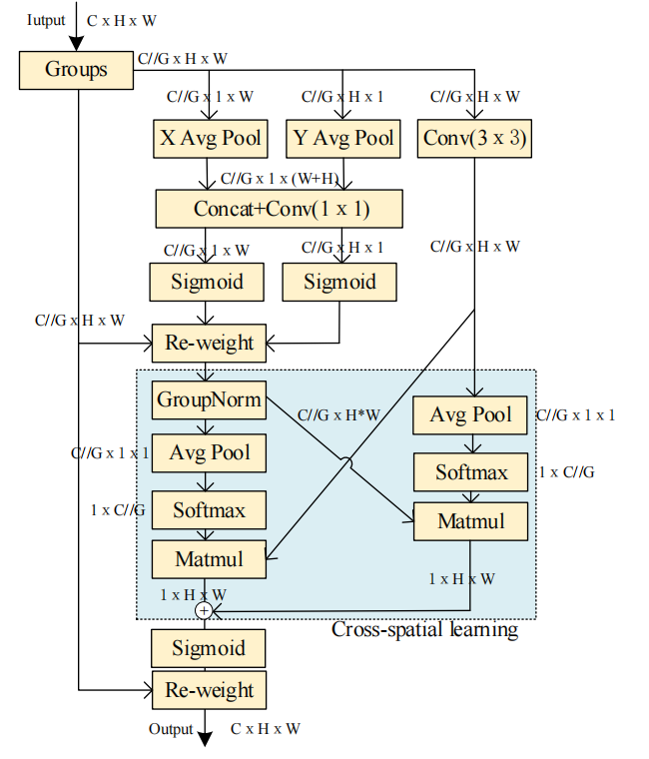

Slide 3
